Slide 1
Big Data, A.I. and Investing
Ken Liu

Slide 2
Sentiment Analysis
Background
Theories on Sentiment Analysis
Example Companies: Thomson Reuters, Amareos
NLP (Natural Language Processing)
Case Studies on Investment and Trading
Group Discussions: Sentiment on investment
Detecting Fake or Deceptive Opinions
Programming Tools & APIs

Slide 3
Background
“All through time, people have basically acted and reacted the same way in the market as a result of: greed, fear, ignorance, and hope. That is why the numerical formations and patterns recur on a constant basis.”
~ Jesse Livermore, How To Trade In Stocks, 1940.
“And if they insist on trying to time their participation in equities, they should try to be fearful when others are greedy and greedy when others are fearful.” [my bold]
~Warren Buffett
Overreaction Creates Discount - “We go where the perceived risk exceeds the actual risk.”
~ Wilbur Ross
Notes:
e.g. People over worry about the typhoon coming and insurance stocks are too over-sold

Slide 4
Background
“Emotional Priming” (Trujillo et al, 2007 & Genevsky and Knutson, 2015)
Investment experiment:
Subjects choose:
$10
A coin flip ($30 H : $0 T)
Seeing a happy face increased risk-taking (choosing the coin flip) by 30% versus angry and fearful faces.
Afterwards subjects denied that the faces had affected their judgment.
Notes:
Expected value = 15 for coin flip and is better
But the key point is the sentiment shift affect decision

Slide 5
Background
Minds, Psychology, Behaviors
Humans are non-rational when faced with risk and uncertainties
Markets, Patterns, Cycles
Market over-reaction and under-reaction
Media, Format
From news and social media comments (textual). In the future will be more from images and videos

Slide 6

Sentiment Theories
Sentiment Analysis Mining Opinions, Sentiments, and Emotions
~ Bing Liu

Slide 7
Types of Sentiment
Sentence Level
The weather is very nice
Though the film dazzles us with its hauntingly beautiful images, it disappoints with its lack of substance.
Paragraph level
Contains multiple sentences
Document level
https://www.pcmag.com/commentary/356586/the-30-year-ai-scare-cycle
Notes:
So what’s the problem of this type of sentiment?

Slide 8
Types of Sentiment
Aspect level (aka feature level)
Discover what people like and dislike exactly (the target of opinion)
“I like the iPhone X” is positive, it is of limited use unless we know that the positive opinion is about the iPhone
“Apple is doing very well in this poor economy.” It does not make much sense to classify this sentence as positive or negative because it is positive about Apple but negative about economy.
“Although the service is not great, I still love this restaurant.” This sentence clearly has a positive tone, but we cannot say that this sentence is entirely positive. We can only say that the sentence is positive about the restaurant (emphasized), but it is still negative about its service (not emphasized). If someone cares a lot about the service, he probably will not go to eat at the restaurant.

Slide 9
Types of Sentiment
Regular opinion is a quadruple (g, s, h, t )
g: target
e: entity , T:(parts, subparts), W {attributes}
s: sentiment
h: holder (person)
t: time
e.g. 2017-1-1 12.50 pm (time): “I(holder) love (sentiment) the sound (attribute) of iPhone X (target)”

Slide 10
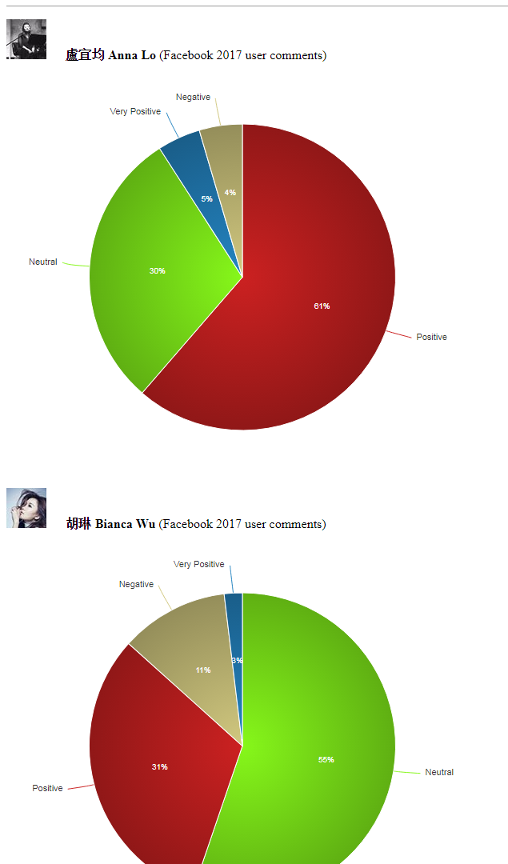
Sentiment Examples
Refer to the Excel for detail breakdown
sentimentAnnaLo
sentimentBiancaWu
sentimentFinancialNews
Stanford Sentiment Demo Website
http://nlp.stanford.edu:8080/sentiment/rntnDemo.html
(refer to first comment)
Notes:
Open the Excel files from Google Drive

Slide 11
Example Companies: Background
Challenges in integrating different social media feeds. Each data source may give a different interface and a different format for delivering data.
Polling websites for updates is complicated by varying latency. Many of the data sources report the same activity multiple times; so there is a need to carefully eliminate duplicates. (show Datatact User Comments)
The language styles differ across sources (e.g. Social Media differs in style from SFC documentation and FB Posts vs Comments).
These technical and operational challenges provide an opportunity for intermediary firms to bridge the gap between investment managers and social media. Typically such firms have a partnership with the data source and they offer a single API through which the client can access multiple sources of data

Slide 12
Example Companies: Main Components
Named entity extraction: extract the identity of the speaker, places/addresses, organizations, products/brands.
Theme and category extraction: Theme is for important phrases e.g. “Fed hike”, “Middle-Eastern crisis”; Category refers to pre-defined buckets into which the sentiment score could be aggregated e.g. stock ticker.
Sentiment: a sentiment score is assigned to the article (usually assume holding the position).
Time Frame: timestamped sentiment score such as aggregated over a time period (e.g. a day), in order to produce date-entity-sentiment tuples. Such tuples form the basis of a trading signal
Relevance and Influence: a metric of relevance is assigned based on its relation to the traded assets. Another metric of influence is assigned to the article/tweet. It could be based on popularity of author, links to other prominent authors, etc.

Slide 13
Thomson Reuters MarketPsych Indices (TRMI)
The next few slides on TRMI is adopted from the presentation of Dr. Richard Peterson and his book.
Trading on Sentiment
The Power of Minds Over Markets

Slide 14
Thomson Reuters MarketPsych Indices (TRMI)
https://financial.thomsonreuters.com/content/dam/openweb/documents/pdf/financial/marketpsych-indices-brochure.pdf
High-speed text analysis on news and social media across the internet globally
Identifying media references to 187 countries, 12,000+ global companies, 61 stock indexes, 45 currencies, 36 commodities.
Derived from 2,000 news and 800 social media sources.
Separate news and social feeds.
• History from 1998-present for both news and social
Uses patented natural language processing software
Highly dimensional: Emotions and complex meanings
Notes:
FB post and comment is like news vs social feeds

Slide 15
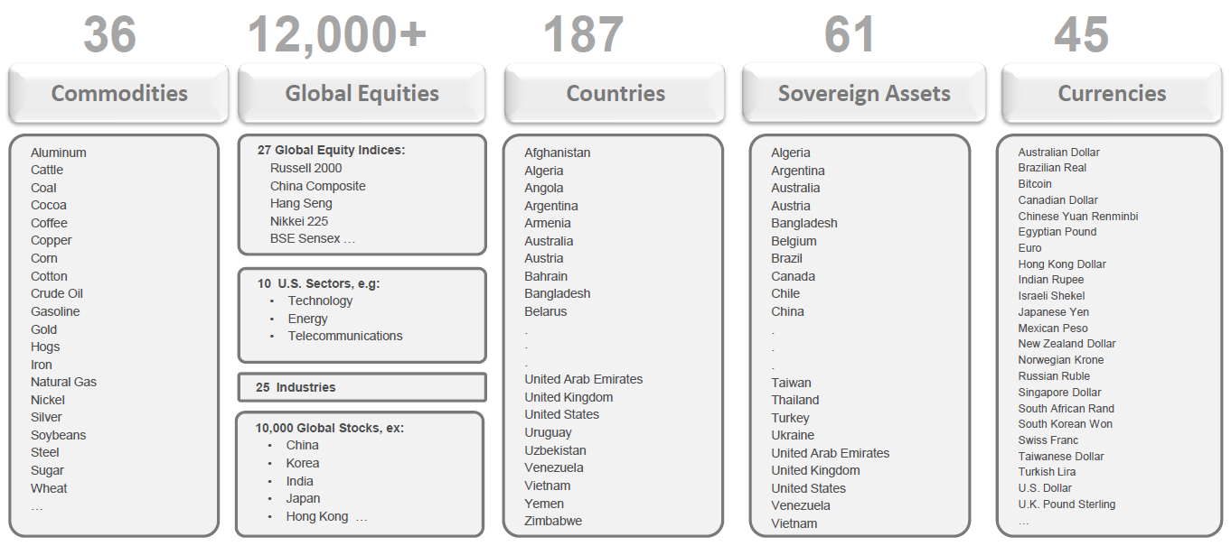
Thomson Reuters MarketPsych Indices (TRMI)

Slide 16
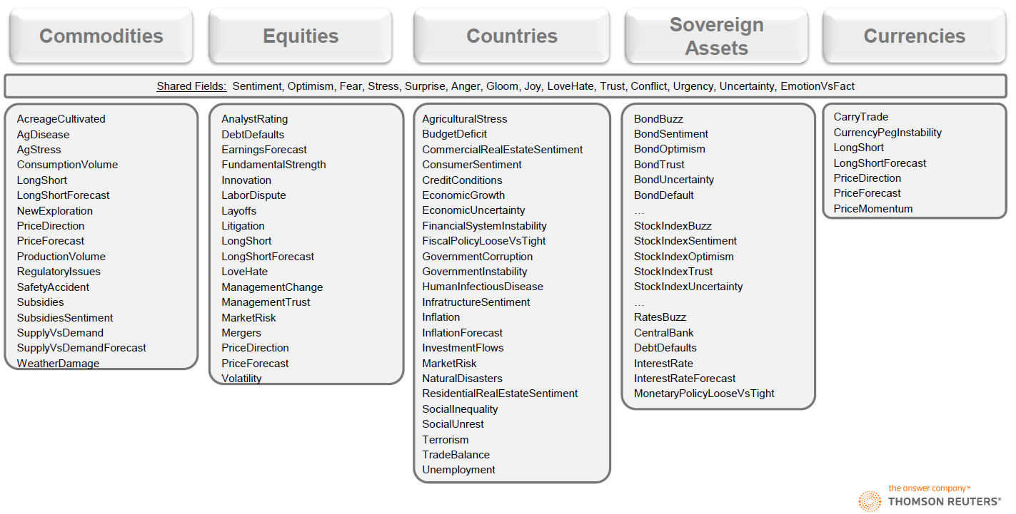
Thomson Reuters MarketPsych Indices (TRMI)

Slide 17
Thomson Reuters MarketPsych Indices (TRMI)
Sentiment and news flow are non-linear.
1. Z-scores: Sentiment deltas or rates of change. Identify market moving events.
2. Decision Trees: Sentiment conditioned on fundamental or technical factors. Improves detection of price overreaction and under-reaction.
3. Moving average crossovers (MACDs): Reduces noise and captures changes and drifts in sentiment over time. Identifies trends and turns.
when short-term average crosses a long-term average -> momentum is shifting in one direction and that a strong move is likely approaching.
A buy signal is generated when the short-term average crosses above the long-term average, while a sell signal is triggered by a short-term average crossing below a long-term average
Notes:
It’s usually not just a single static value of sentiment

Slide 18
Thomson Reuters MarketPsych Indices (TRMI)

Slide 19
Thomson Reuters MarketPsych Indices (TRMI)

Slide 20
Thomson Reuters MarketPsych Indices (TRMI)
Notes:
It’s like the 250 day MA (moving average) crossover 10-day MA

Slide 21
Thomson Reuters MarketPsych Indices (TRMI)

Slide 22
Amareos
https://www.amareos.com/
The following few slides is adopted from Amareos Web Site
Notes:
Go to the company web site
Met with the CEO in CWB office – Phillipe
Big Data definition - Compare to tech (more than one computer)

Slide 23
Amareos

Slide 24
Amareos
Notes:
It’s like 250 MA (moving average) cross over 50 MA etc

Slide 25
Amareos
Notes:
I think more useful in commodities (gold, oil) / index etc than individual stocks as it may not have enough data on just particular stock
I think sentiment is a little bit more for long to mid-term trading and for Portfolio selection
Trading (short-term) is still mostly on order book

Slide 26
Example Companies: Others
Accern: www.accern.com
Sentiment Trader: www.sentimentrader.com
Social Alpha: www.social-alpha.com
Social Market Analytics: www.socialmarketanalytics.com
Twitter Developer for Enterprise Finance: https://developer.twitter.com/en/enterprise/finance
HSI Volatility Index Futures (like VIX Index):
https://www.hkex.com.hk/Products/Listed-Derivatives/Equity-Index/Hang-Seng-Index-(HSI)/HSI-Volatility-Index-Futures?sc_lang=en#&product=VHS

Slide 27
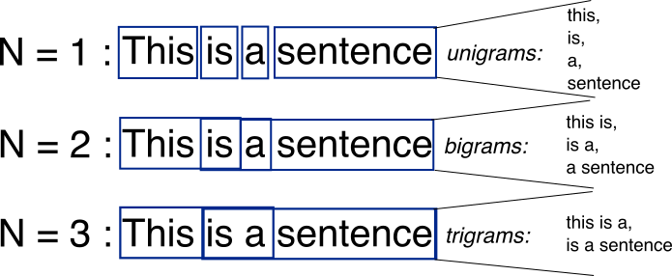
Natural Language Processing (NLP)
N-Gram
an n-gram is a contiguous sequence of n items from a given sequence of text or speech. The items can be phonemes, syllables, letters, words or base pairs according to the application. The n-grams typically are collected from a text or speech corpus.
Example in CV understanding: phrases are more meaningful than individual words (e.g. “Java”, “Developer” -> “Java Developer”)
Notes:
Learn from Corpus

Slide 28
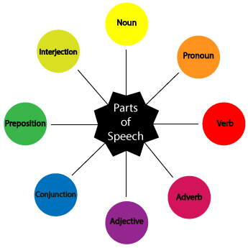
Natural Language Processing (NLP)
POS (Part of speech)
POS tagging is the process of marking up a word in a text (corpus) as corresponding to a particular part of speech, based on both its definition and its context—i.e., its relationship with adjacent and related words in a phrase, sentence, or paragraph
Example in Sentiment Analysis: adjective (good, bad) is more important than other POS

Slide 29
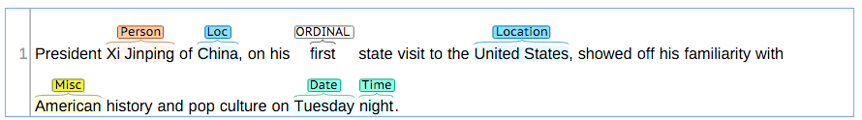
Natural Language Processing (NLP)
NER (Named Entity Recognition)
locate and classify named entities in text into pre-defined categories such as the names of persons, organizations, locations, expressions of times, quantities, monetary values, percentages, etc.

Slide 30
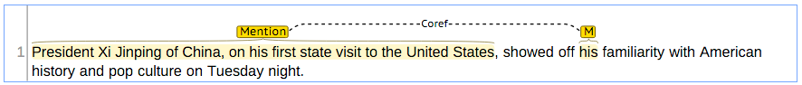
Natural Language Processing (NLP)
Co-reference
occurs when two or more expressions in a text refer to the same person or thing
When two expressions are co-referential, the one is usually a full form (the antecedent) and the other is an abbreviated form (anaphor)

Slide 31
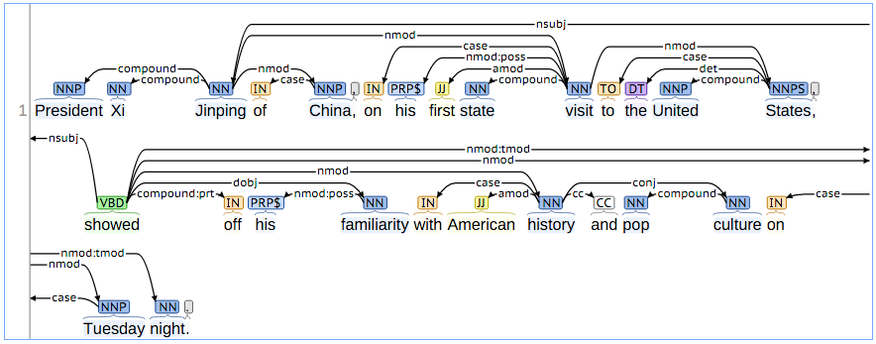
Natural Language Processing (NLP)
Annotation

Slide 32
Natural Language Processing (NLP)
Tokenization (e.g. Chinese segmentation)
Stemming and Lemmatization
Documents use different forms of a word. Additionally, there are families of derivationally related words with similar meanings.
Reduce inflectional and derivationally forms of a word to a common base form.
Inflectional Forms: organize, organizes, and organizing
Derivationally: democracy, democratic, and democratization
Example in Search: for one of these words to return documents that contain another word in the set.

Slide 33
Natural Language Processing (NLP)
Information Extraction
automatically extracting structured information from unstructured (human languages) and/or semi-structured (machine-readable) documents
Summarization
process of shortening a text document, in order to create a summary with the major points of the original document
Text Similarity
Estimate the degree of similarity between two or multiple texts
Example: Catching multiple similar FB comments
Notes:
Text similarity : plagiarism, spam detection etc

Slide 34
Natural Language Processing (NLP)

Slide 35
Natural Language Processing (NLP)
Automatic News Summary
https://www.inside.com.tw/2017/01/19/bot-produce-news
Content Farm - Buzz Feed
employs large numbers of freelance writers to generate large amounts of textual content which is specifically designed to satisfy algorithms for maximal retrieval by automated search engines.
https://www.buzzfeed.com
Notes:
Use keyword correlation for HK01 editor to write articles

Slide 36
Part-of-Speech (POS)
https://nlp.stanford.edu/~manning/papers/tagging.pdf
explicit use of both preceding and following tag contexts via a dependency network representation,
broad use of lexical features, including jointly conditioning on multiple consecutive words,
effective use of priors in conditional log-linear models
fine-grained modeling of unknown word features. Using these ideas together, the resulting tagger gives a 97.24% accuracy on the Penn Treebank WSJ, an error reduction of 4.4% on the best previous single automatically learned tagging result.
Notes:
Treebank & Corpus (WSJ)

Slide 37
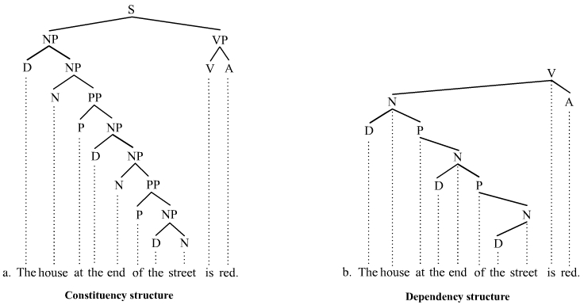
Treebanks
Notes:
Corpus, Treebank: manually prepare a lot data

Slide 38
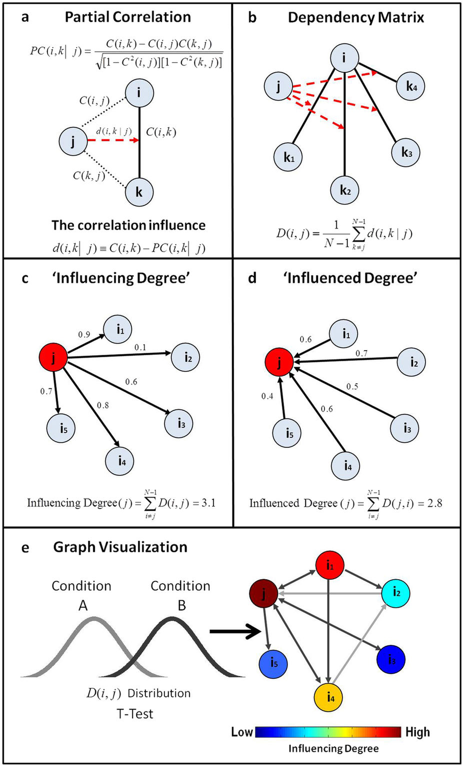
Dependency Network
system level analysis of the activity and topology of directed networks
extracts causal topological relations between the network's nodes, and provides an important step towards inference of causal activity relations between the network nodes

Slide 39
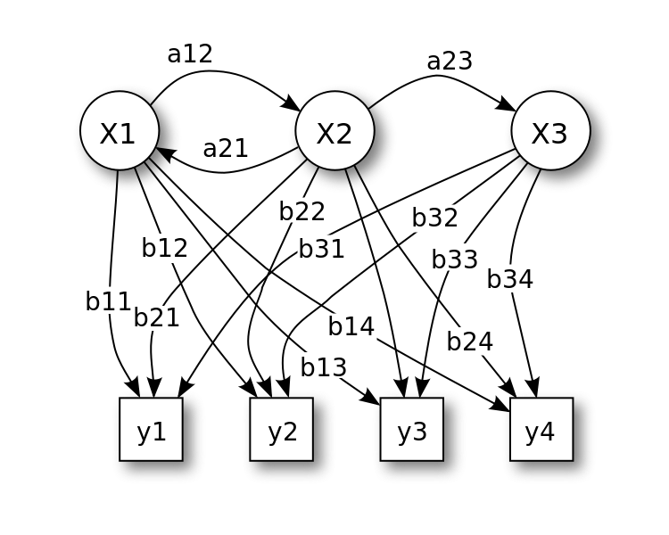
HMM (Hidden Markov Model)
Study sequence
Markov process where the last state is only depends on previous state
Hidden mean the state cannot be directly observed
Probabilistic parameters of a HMM
X — states
y — possible observations
a — state transition probabilities
b — output probabilities
Notes:
Sentence is sequence of different words

Slide 40
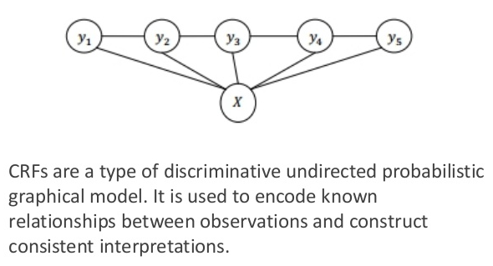
Conditional Random Fields
Tokenization (Chinese Word Segmentation)
https://nlp.stanford.edu/pubs/acl-wmt08-cws.pdf
Based on Penn Chinese Treebank (CTB) Segmentation Standard
Use CRF (Conditional Random Fields)
Notes:
Better than brute force

Slide 41
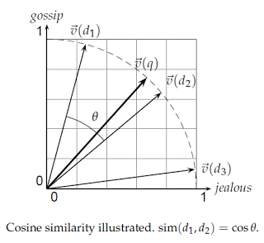
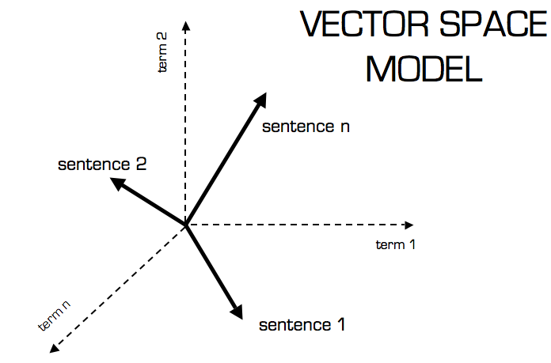
Vector Space Model
Representing text documents as vectors of identifiers. Each dimension corresponds to a separate term. If a term occurs in the document, its value in the vector is non-zero.
Use cosine similarity (e.g. dot product) to calculate the text similarity
Demo: http://projector.tensorflow.org/ Example: Search “大交合”

Slide 42
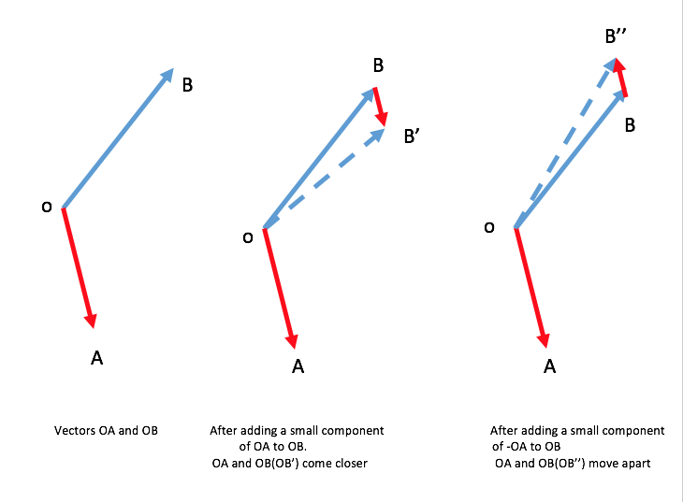
Word2Vec - Definition
Context: a fixed number of words in front of and behind the word of interest
Example: Mary is a very stubborn child. Her pervicacious nature always gets her in trouble: pervicacious is surrounded by stubborn, nature, and trouble. Learns the meaning of a given word by looking at its context and representing it numerically.
“a word is characterized by the company it keeps - John Rupert Firth”

Slide 43
Word2Vec – Similarity
most_similar('car')
[('cars', 0.5899946093559265),
('vehicle', 0.5460749864578247),
('vehicles', 0.455700546503067),
('auto', 0.38780486583709717),
('suv', 0.3466867208480835),
('minivan', 0.3353206515312195),
('truck', 0.31946268677711487),
('minicar', 0.3166467249393463),
('home', 0.314445436000824),
('bike', 0.3133225739002228)]
most_similar('risk')
[('risks', 0.5921677947044373),
('probability', 0.4140169024467468),
('likelihood', 0.3951364755630493),
('possibility', 0.3811781406402588),
('uncertainty', 0.34543055295944214),
('challenge', 0.322320818901062),
('concern', 0.288372278213501),
('uncertainly', 0.2852689027786255),
('odds', 0.271675169467926),
('threat', 0.2695636749267578)]

Slide 44
Word2Vec – Dissimilarity
doesnt_match('revenue tax sales income'.split())
Out: 'tax'
doesnt_match('apple samsung microsoft'.split())
Out: 'microsoft'
doesnt_match('apple ibm microsoft'.split())
Out: 'apple'
doesnt_match('dy pe pb growth'.split())
Out: 'growth'
doesnt_match('car pe pb growth'.split())
Out: 'car'
doesnt_match('excellent good bad'.split())
Out: 'bad'

Slide 45
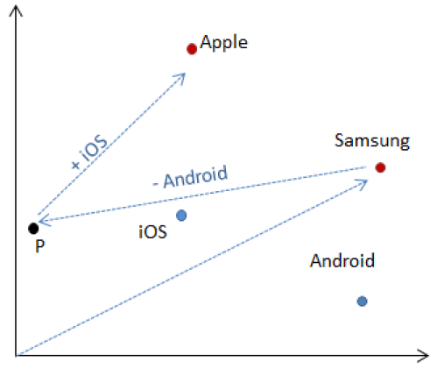
Word2Vec - Addition and subtraction
most_similar(
positive=['samsung', 'ios'],
negative=['android'])
[('apple', 0.35112401843070984),
('compal', 0.2893127202987671),
('renesas', 0.28568124771118164),
('sdc', 0.26545387506484985),
('memory', 0.26283740997314453),
('samsungs', 0.26225510239601135),
('netapp', 0.260621041059494),
('everlight', 0.2575075924396515),
('sec', 0.2570921778678894),
('wematch', 0.2497785985469818)]

Slide 46
Word2Vec - Corpus comparison
JPMA | Google News
Driver
contributor | drivers
drivers | Driver
catalyst | motorist
determinant | driving
culprit | car
beneficiary | motorcyclist
determinants | wheel
differentiator | Drivers
detractor | truck
contributors | vehicle
JPMA | Google News
overweight
neutral | Overweight
ow | underweight
underweight | obese
uw | morbidly_obese
constructive | obesity
cautious | Underweight
selective | severely_obese
pt | metabolic_syndrome
intact | waist_circumference
bullish | BMI

Slide 47
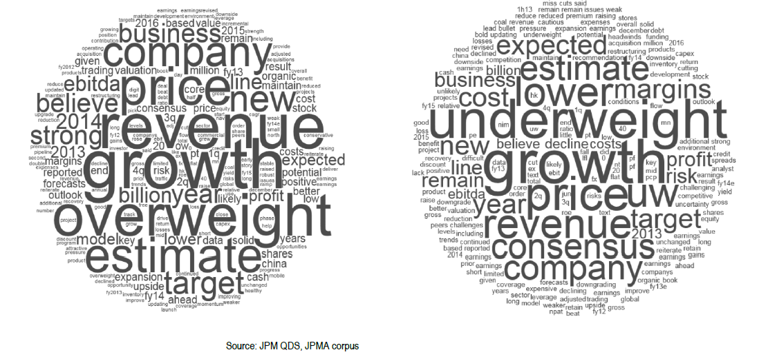
Word2Vec – Sentiment Analysis

Slide 48
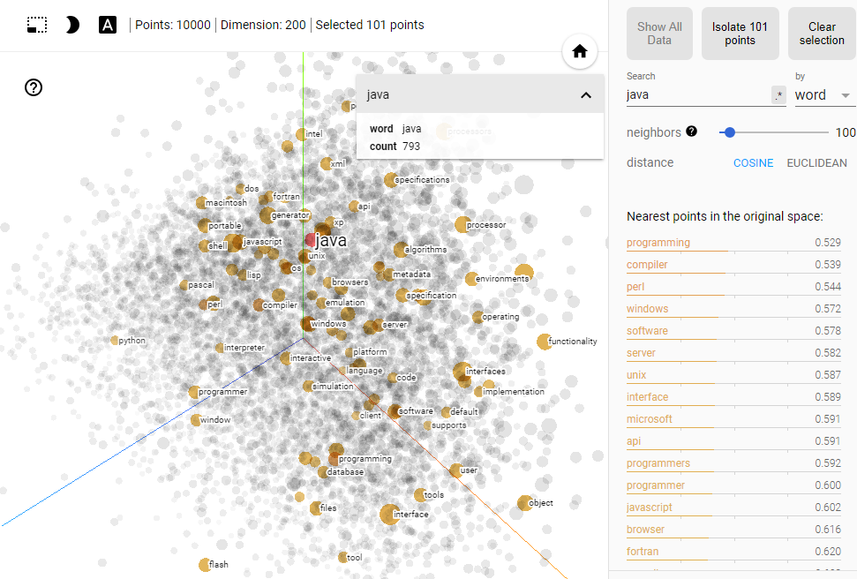
Word2Vec – Training and Demo

Slide 49
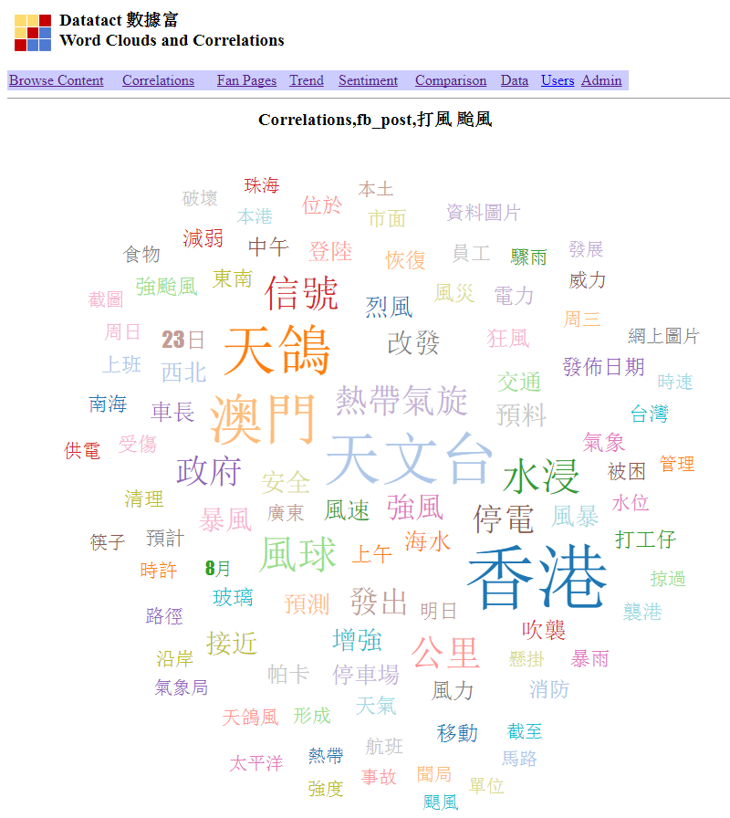
Word2Vec – Compare to others
vs “Keyword Correlation”
multi-dimensions vs 1-dimenson: can calculate angle and have arithmetics
have the window length to determine the relevant context
requires longer time to train the model
vs Treebank
no need for human labeling
like native speakers learning its own language. Doesn't learn grammar and just pick up on what other people talk

Slide 50
Case Studies: Twitter Sentiment S&P 500
iSentium provides real-time sentiment time series based on Twitter messages. It is effectively a sentiment search engine.
Provide investors with a way to judge the potential market impact of a tweet, a news article, or other social media activities.
Backtests of iSentium Daily Directional Indicators (DDI) indicate that social media sentiment can be used as a predictor for short term market moves.
J.P. Morgan has constructed the JPUSISEN Index that takes intraday long or short positions in the S&P 500 Index, based on a daily directional indicator provided by iSentium

Slide 51
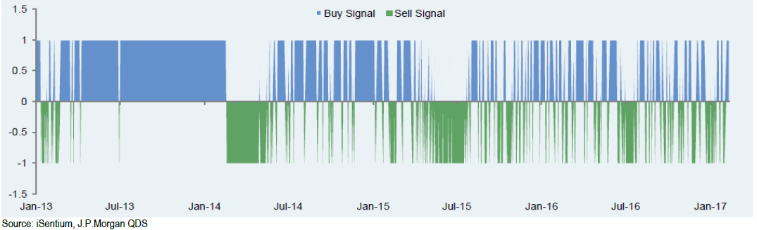
Case Studies: Twitter Sentiment S&P 500
The universe is limited to the 100 stocks which are most representative of the S&P 500, filtered using tweet volume and realized volatility measures.
Tweets are assigned a sentiment score using a patented NLP algorithm.
By aggregating tweet scores, a sentiment level is produced per minute between 8:30 AM and 4:30 PM every day.
Sentiment for the day is aggregated using an exponentially weighted moving average over the past ten days.
S&P 500 returns are forecasted using a linear regression over the sentiment scores for the past two days, with betas evolved via a Kalman filter.

Slide 52
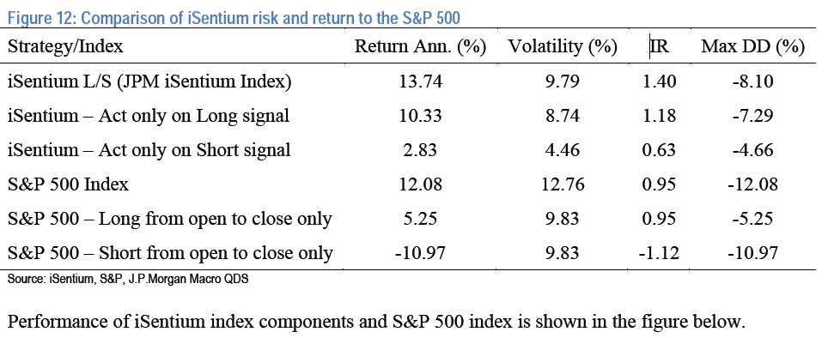
Case Studies: Twitter Sentiment S&P 500
IR = Information Ratio; Max DD% = Max Draw Down%
Period is from 2013 to 2017 and why Long Signal is more profitable

Slide 53
Case Studies: Sentiment to trade Bonds
RavenPack analyzes unstructured datasets to produce structured and granular indicators of relevance to investment professionals. Unstructured data include premium newswires, regulatory news providers, press releases and over 19,000 web publications.
The usage of RavenPack news sentiment data in trading currencies, sovereign bonds and commodities.
Calculated daily sentiment scores for different assets of interest from RavenPack’s raw newsfeed (>150GB of CSV files)
Constructed simple long-short strategies: going long assets with the top 3 sentiment scores, and shorting assets with the bottom 3 sentiment scores.

Slide 54
Case Studies: Sentiment to trade Bonds
Translating RavenPack News Feed into Daily Sentiment Score (50 data fields for each event. Analyzed data since 2005 for each asset of interest.
Isolate all unique events on a given day specific to a certain “ENTITY_NAME”. Entity name was set equal to the currency, commodity or country name. Set a cutoff time of 4 PM EST to reflect NY market close.
“RELEVANCE”: which is an integer score between 0 and 100. A higher value indicates that the mention of the entity is more integral to the underlying news story. Used RELEVANCE as a cut-off filter, ignoring stories with a value < 75.
“EVENT_SENTIMENT_SCORE”: a granular score between -1.00 and +1.00 that represents the news sentiment for a given entity. The average of ESS for all filtered events was designated as the sentiment value for the day. Forward-filled the sentiment for days on which no news was received by the analytics engine.

Slide 55
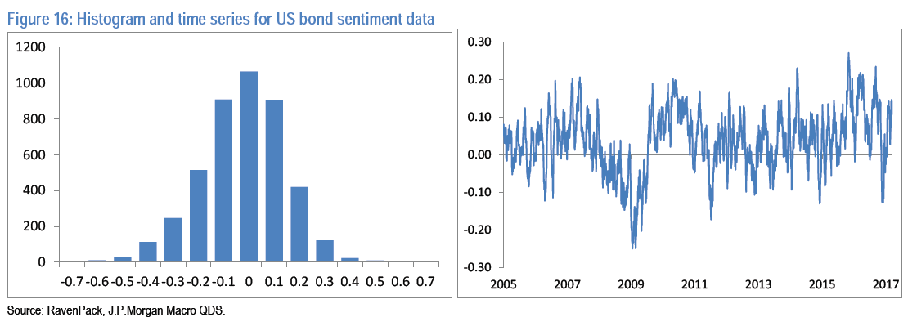
Case Studies: Sentiment to trade Bonds
Sovereign Bonds
A daily long-short strategy is constructed from currency-hedged returns of sovereign bonds from Australia, Canada, Denmark, Germany, United Kingdom, Japan, Sweden, New Zealand and the United States.
RavenPack does not issue a ‘bond sentiment’ indicator; so used economic sentiment as a contrarian indicator; we go long the 3 bonds with the most negative economic sentiment and short the 3 with the most positive sentiment.

Slide 56
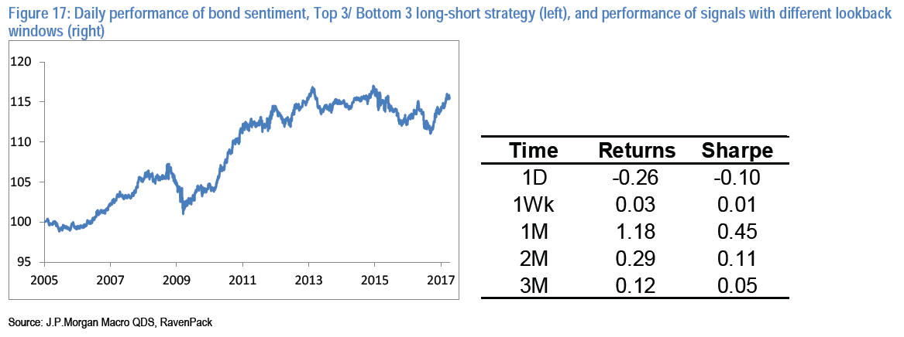
Case Studies: Sentiment to trade Bonds
Using average sentiment value as signal, we obtained positive annualized returns and Sharpe Ratios in a 0 to 0.5 range.
For instance the top 3 / bottom 3 portfolios where we take 1-month average of sentiment as a signal, yields a Sharpe ratio of 0.45. Results are somewhat sensitive to the lookback window for signal averaging as shown in the figure below.

Slide 57
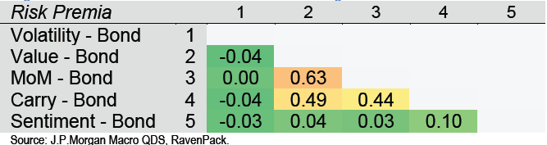
Case Studies: Sentiment to trade Bonds
Correlation of this bond sentiment strategy with traditional bond risk factors: Value, Momentum, Carry, and Volatility, was nearly zero (less than 4%) over the past 10 years. Despite relatively low Sharpe ratios, the sentiment signal may be useful in a portfolio context (i.e. when combined with other signals).

Slide 58
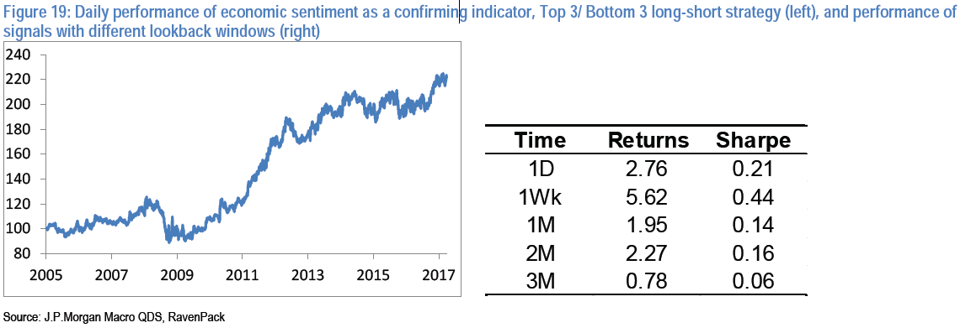
Case Studies: Sentiment to trade Indexes
Equity Indices: A daily long-short strategy is constructed from benchmark equity indices of Australia, Canada, Denmark, Germany, United Kingdom, Japan, Sweden, New Zealand and United States.
Using RavenPack’s economic sentiment signal as a confirming indicator to go long/short equity indices. We obtain the following results:

Slide 59
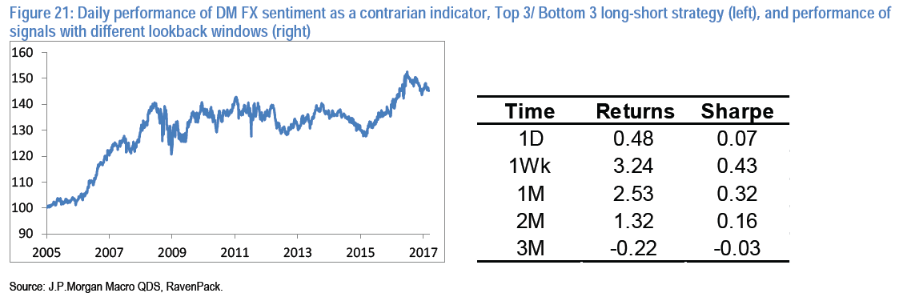
Case Studies: Sentiment to trade Currencies
Developed-Market Currencies: A daily long-short strategy for currencies: Australian Dollar, Canadian Dollar, Swiss Franc, Danish Krone, Euro, British Pound, Japanese Yen, Norwegian Krone, New Zealand Dollar and Swedish Krona
Used a currency-specific sentiment indicator. The strategy held long the 3 currencies with the most negative sentiment and held short the 3 currencies with the most positive sentiment. Interestingly using average sentiment value as a contrarian signal and it resulted in moderately positive results (Sharpe ratios in a 0 to 0.4 range).

Slide 60
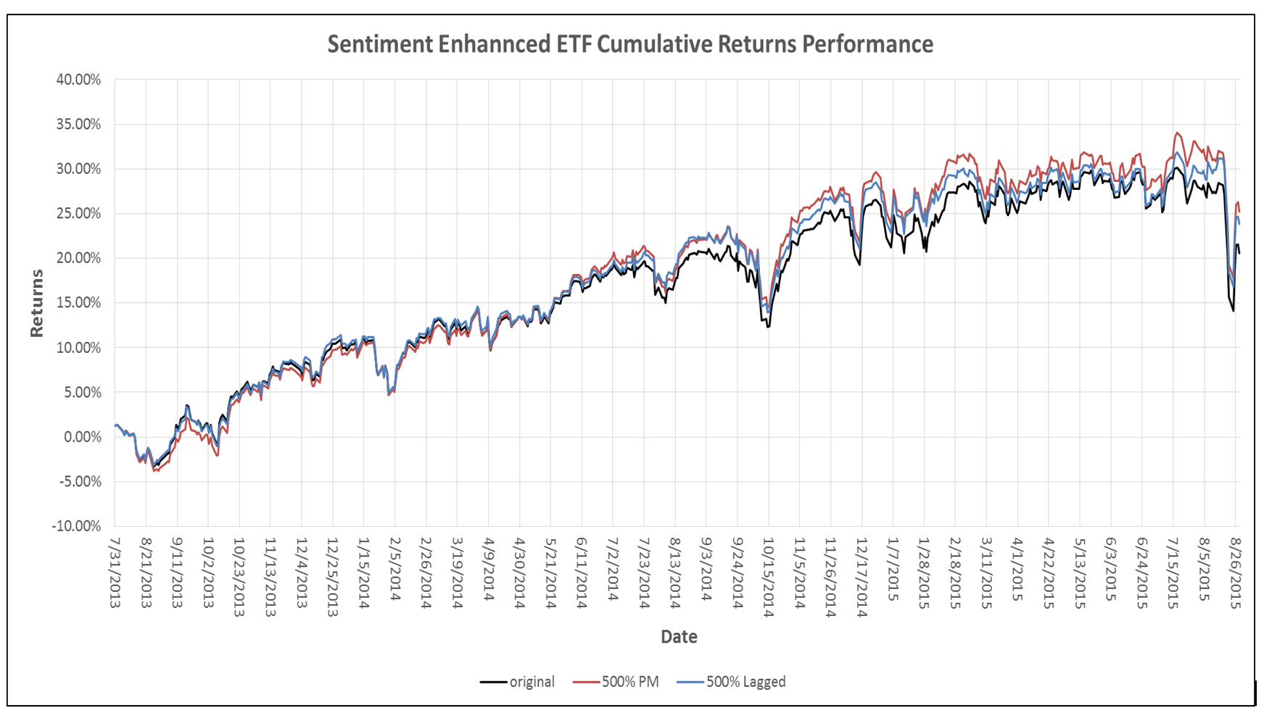
Case Studies: Smart Beta
Using the social media sentiment levels of individuals ETF constituents to rebalance the weights of the constituents in the ETF while keeping the Assets under Management constant
https://socialmarketanalytics.wordpress.com/2015/10/27/social-media-and-smart-beta/

Slide 61
Discussion: Sentiment on investment
Sentiment add more info or noise for investment and trading
Data source: news, social media, coverage (biased?), What is the right data source for Sentiment Analysis in HK (WhatsApp message)?
Methodologies: how it calculate the score
Timeframe: sentiments has future (time lag) predicting power and for how long (duration)? (is market data after the fact and less predictive?)
Combination: Is it useful to combine with the traditional data (tech indicators/ company reports)
Datatact keywords social index
Each item has a set of top related keywords (beta coefficient)
Can we apply word2vec?
Duration and time-lag of the words
Any sentiment based applications?

Slide 62
Detecting Fake or Deceptive Opinions
Professional reviewers are often easier to catch because they write a large number of fake reviews, which can leave linguistic and behavioral patterns easily discoverable by data mining algorithms. However, the issue is that by the time they are caught, the damage might have already been done because it takes some time and possibly many fake reviews for the system to detect abnormal writing styles and behavioral patterns.
Example: someone frequently checked a restaurant review page without writing anything. When the person saw a negative review appeared on the page, he quickly wrote a strong positive review. Clearly this positive review is suspicious because the person could be the restaurant owner to mitigate the impact of the negative review.

Slide 63
Detecting Fake or Deceptive Opinions
Group spamming - works in collusion to promote a target entity and/or to damage the reputation of another. The individual spammers in the group may or may not know each other or each other’s activities
A single person or organization registers multiple accounts. These multiple accounts behave just like a group working in collusion. This is called sock puppeting.
In the case of an organization, there are different sub-models: multiple people posting from these accounts, one person in charge of several accounts, or a mixture of both. Some so-called reputation management companies and government agencies work in this way. (打手, buying likes in Facebook etc)
Notes:
Some FB example

Slide 64
Types of Data, Features, and Detection
Review content: The text content of each review including, we can extract linguistic features such as POS (Part of Speech), n-grams and other syntactic, semantic, and stylistic clues for deceptions and lies. However, linguistic features are often not sufficient because one can fairly easily craft a fake review that is just like a genuine one
- Meta-data: such as the star rating given to each review, userid of the reviewer, the time/date when the review was posted, the number of helpfulness votes, and the number of votes. From these pieces of data, many features can be generated. E.g. we can compute the no. of reviews written by a reviewer in a day. If the number is too large, the reviewer is suspicious. From the ratings, we may find that a reviewer wrote only positive reviews for a brand and only negative reviews for a competing brand.
Notes:
Using similar way in Datatact FB – how frequency of comment from single person
Text similarity in progress

Slide 65
Types of Data, Features, and Detection
Web usage data: every website records the activities the website such as the sequence of clicks, the time when each click is made, how much time a user stays on a page, the time taken to write a review.
They are collected by the web server. Each HTTP request, generates a log entry and may contain timestamp, the IP address, the resource requested, user agent, location (GPS), client-side cookies which uniquely identifies a repeat visitor.
Abnormal behavioral patterns: we may find that multiple userids from the same computer posted multiple positive reviews for a product. If the positive reviews for a hotel are all from the nearby area of the hotel, they are also not trustworthy. If a person monitors the review page writes a positive review, the person is also suspicious because she cares about the business on the page too much. She may be the business owner.

Slide 66
Types of Data, Features, and Detection
Sales information. business-related information such as the sales volume and the sales rank of a product in each period of time. This information is useful for spam detection because the number of products sold should be roughly correlated to the number of reviews posted. If a product is not selling well but has many positive reviews, it is hard to believe. Here the product can also means a business or a service.
Product information: for example, product brand, model, type/category, and description.

Slide 67
Types of Data, Features, and Detection
Public data: the data displayed on the review pages of the hosting site, for example, review content, review meta-data, and possibly some available product information.
Site private data. The data that the site collects but is not displayed on their review pages for public viewing. Such data mainly include web usage data, and sales data.
(Due to privacy concerns of review hosting companies, most algorithms are based on the public data.)

Slide 68
Types of Data, Features, and Detection
http://hkm.appledaily.com/detail.php?issue=20170505&guid=56654539&category_guid=7015342&category=instant
Facebook Issues and people suspect of fake account closing.
http://blog.datapoolt.co/how-buzzfeed-changed-social-media-analytics-and-what-it-means-for-the-rest-of-us/
Notice there are no UTM terms trailing in the URL that's traditionally used for tracking. There's a parameter called utm_term with a randomly generated string that appends itself to the URL! Copying the link and pasting it elsewhere would again generate another random string and so on. Tracking the change in this parameter from the point of origin thus enables Buzzfeed to track the journey across multiple channels and mediums easily.
Notes:
UTM, cookies are stealing a lot of information

Slide 69
Detect fake review/reviewer
Detachment: liars often try to avoid statements of ownership either to “dissociate” themselves from their words or due to the lack of personal experiences. This results in fewer uses of first-person pronouns such as I, me, my, and so on, but with more use of third-person pronouns such as she, he, and they.
(Newman et al., 2003)

Slide 70
Detect fake review/reviewer
Lowering cognitive complexity. Liars need to make up false stories, which is a highly complicated cognitive task. Lies typically use of more negative emotion words (hate, worthless, sad), fewer “exclusive” words, and more motion/action words
1. Using fewer exclusive words such as but, except, without. Sentences using
such words often require a person to know the intricate details of a task or
situation. Without true experiences, it is hard to know such details and thus
to use these words.
2. Using more motion verbs. The easiest thing to do is to describe some actions using motion words such as walk, move, go. It is much harder to create detailed evaluation and judgment as they need to consume significantly more cognitive resources without one’s experiencing the situation firsthand.

Slide 71
Detect fake review/reviewer
Fake reviews have similarities. The frequency of action/motion words does seem to be higher in fake reviews than in truthful reviews. Fake reviewers tend to use more general opinion words such as great, good, wonderful, and so on, rather than specific opinion words to evaluate specific features of products and services based on their actual performances.
Fake reviews from business owners and their employees often sound too knowledgeable about the business and thus read like advertisements, while fake reviews from paid reviewers who know little about the businesses often contain empty praises and lack depth or details. (One simple and effective way is to write a fake review for a product/service by recalling a true experience of using a similar product/service).

Slide 72
Detect fake review/reviewer
Techniques Overview
Supervised Learning Using Linguistic Features
Supervised Learning Using Behavioral Features
Abnormal Patterns Class Association Rules
Learning in a Similarity Space

Slide 73
News, Trends and Examples
https://www.wikitribune.com/
Evidence-based journalism
https://www.theatlantic.com/magazine/archive/2017/09/when-silicon-valley-took-over-journalism/534195/
Facebook/Twitter become newspaper
Personal experience during travel: casual information/images and jokes create false impression or incorrect association.

Slide 74
Programming Tools & APIs
Java: Stanford CoreNLP
Home Page: https://stanfordnlp.github.io/CoreNLP/
Demo: http://nlp.stanford.edu:8080/corenlp/
Sentiment Treebank: https://nlp.stanford.edu/sentiment/treebank.html
Sentiment Demo: http://nlp.stanford.edu:8080/sentiment/rntnDemo.html
Translation System: https://nlp.stanford.edu/phrasal/
Python: http://www.nltk.org/

Slide 75
Concluding Remarks
Macro indicators or sentiment are more suitable for longer term investment
News sentiment is more suitable for mid frequency trading
Social Media sentiment is faster and can be used for short term trading
Adding sentiments to fundamental or technical analysis, is it adding more info or noise?
Need to understand the data source and the methodologies

Slide 76
Further readings
Sentiment analysis of tweets with python, nltk, word2vec & scikit-learn
Beyond positive or negative: Qualitative sentiment analysis of social media reactions to unexpected stressful events - Computers in Human Behavior, March 2016, Vol.56, pp.179-191
Sentiment analysis of Chinese micro-blog text based on extended sentiment dictionary -Future Generation Computer Systems, April 2018, Vol.81, pp.395-403
A Review of Sentiment Analysis Research in Chinese Language - Cognitive Computation, 2017, Vol.9(4), pp.423-435

Slide 77

Thank you

